Slide 1
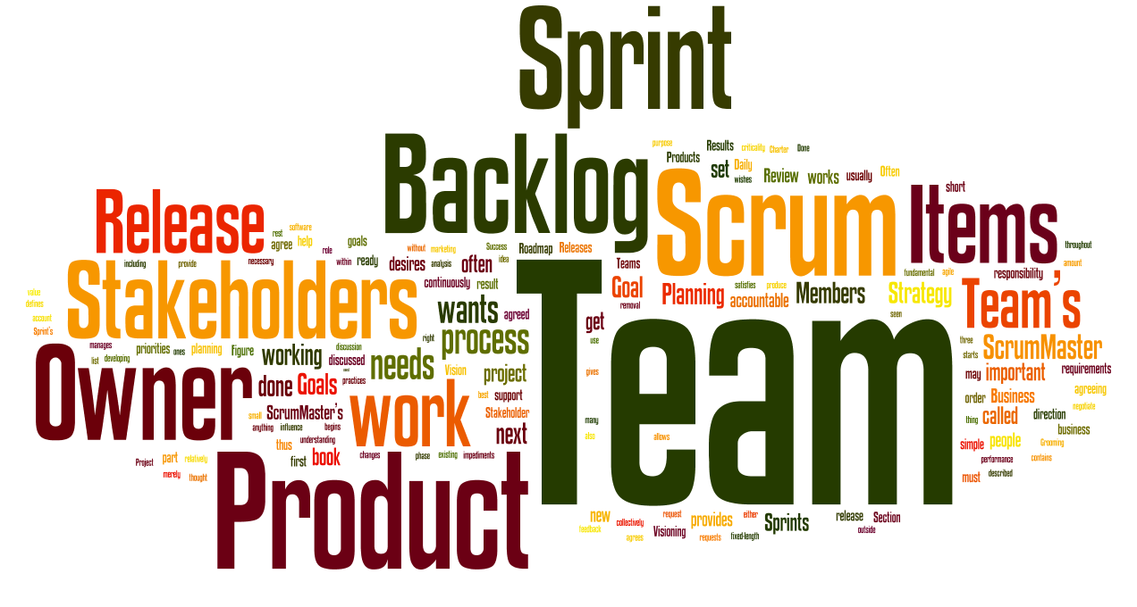
5. Scrum

Slide 2

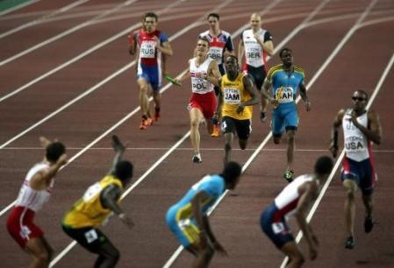
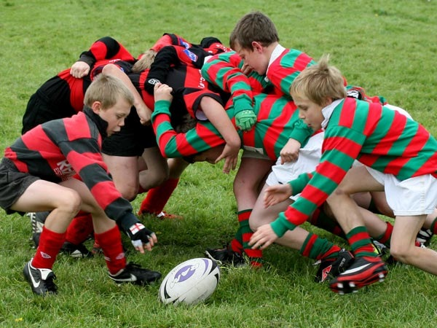
We’re Losing the Relay Race
“The… ‘relay race’ approach to product development…may conflict with the goals of maximum speed and flexibility. Instead a holistic or ‘rugby’ approach—where a team tries to go the distance as a unit, passing the ball back and forth—may better serve today’s competitive requirements.”
Hirotaka Takeuchi and Ikujiro Nonaka, “The New New Product Development Game”, Harvard Business Review, January 1986.

Slide 3
Scrum
Image source:
http://uk.eurosport.yahoo.com/02092007/8/photo/general-shot-4x400m-relay-race.html
http://www.sports-corporate.co.uk/uploads/sports_pics/rugby.jpg
Notes:
Scrum enables iterative incremental development by involving whole team.

Slide 4
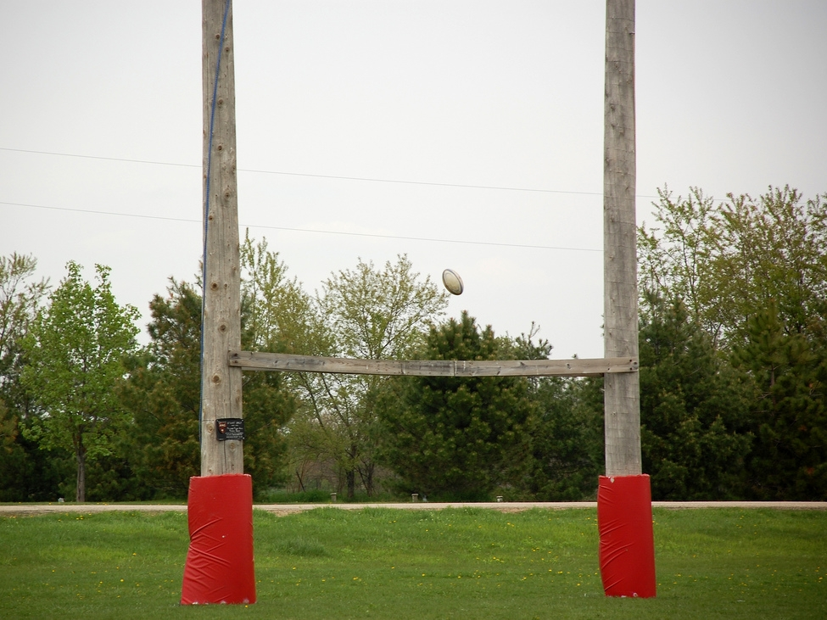
The Goal of Scrum
Manage Complexity, Unpredictability and Change
through Visibility, Inspection and Adaptation

Slide 5
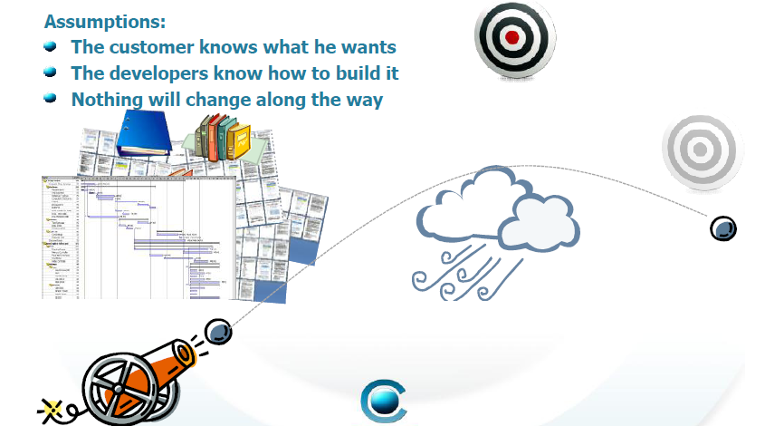
Waterfall is like Cannonball

Slide 6
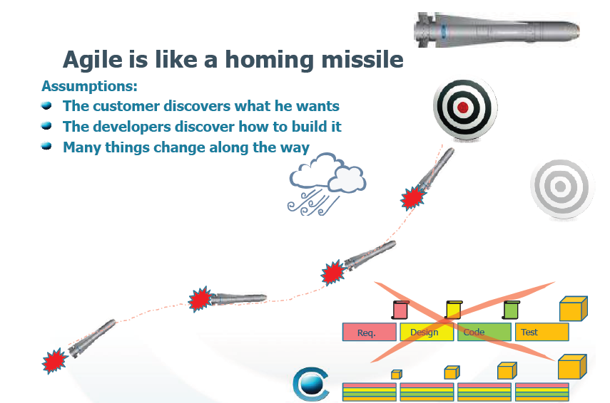
Scrum is like Homing Missile

Slide 7
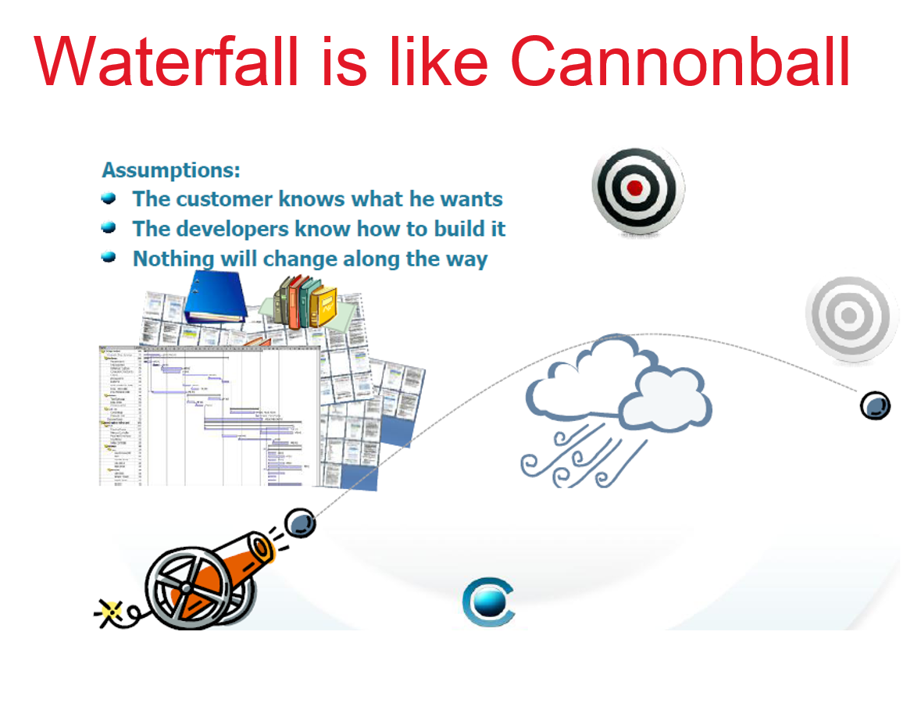
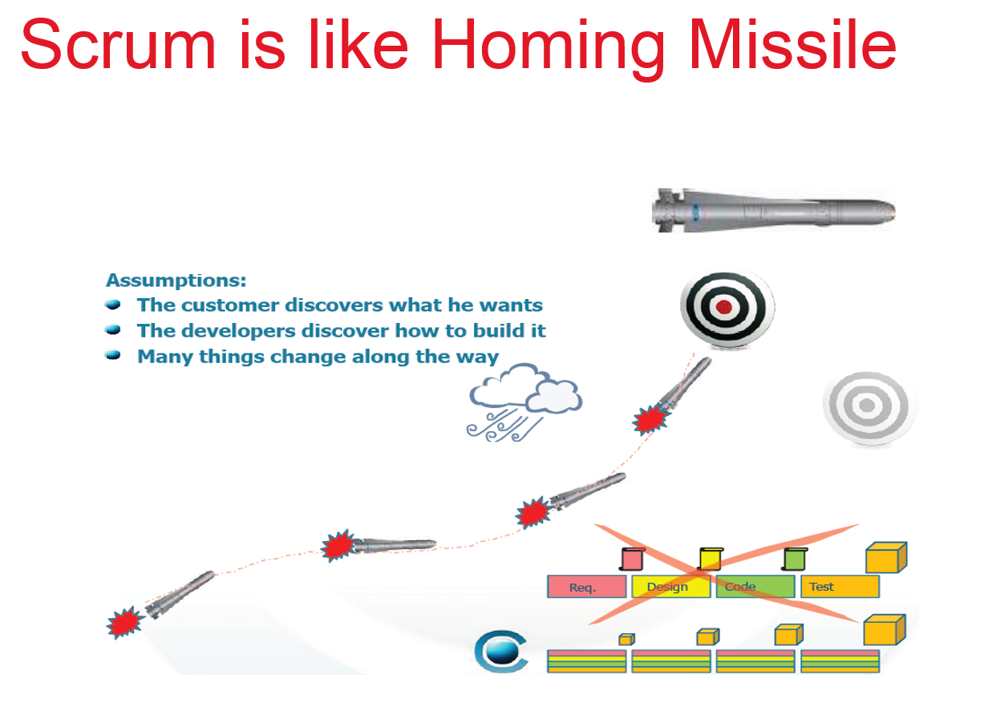
Cannonball vs. Homing Missile

Slide 8
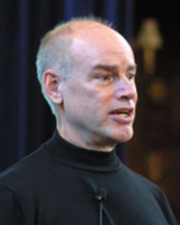
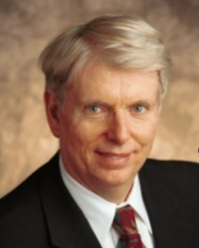

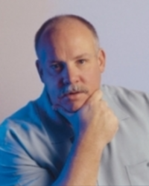
The Gurus
Ken Schwaber
Jeff Sutherland
Mike Beedle
Mike Cohn

Slide 9
Scrum in 100 words
Scrum is an agile process that allows us to focus on delivering the highest business value in the shortest time.
It allows us to rapidly and repeatedly inspect actual working software (every two weeks to one month).
The business sets the priorities. Teams self-organize to determine the best way to deliver the highest priority features.
Every two weeks to a month anyone can see real working software and decide to release it as is or continue to enhance it for another sprint.

Slide 10
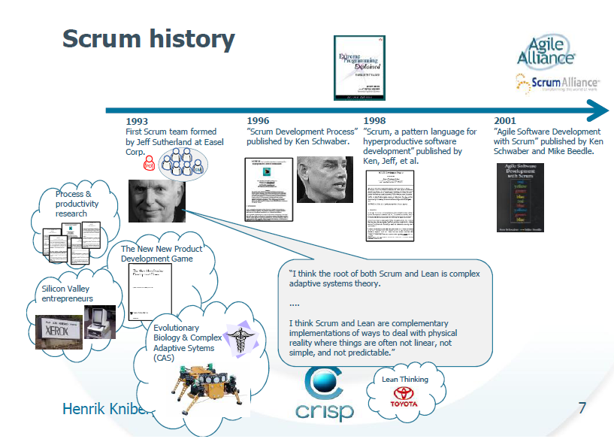
Scrum History

Slide 11
What is Scrum?
Definition from rugby football:
a scrum is a way to restart the game after an interruption, where the forwards of each side come together in a tight formation and struggle to gain possession of the ball when it is tossed in among them

Slide 12
Scrum - a Lightweight Process
SCRUM is a lightweight process for managing and controlling software and product development in rapidly changing environments.
Iterative, incremental process
Team-based approach
developing systems/ products with rapidly changing requirements
Controls the chaos of conflicting interest and needs
Improve communication and maximize cooperation
Protecting the team form disruptions and impediments
A way to maximize productivity

Slide 13
Characteristics
Self-organizing teams
Product progresses in a series of month-long “sprints”
Requirements are captured as items in a list of “product backlog”
No specific engineering practices prescribed
Uses generative rules to create an agile environment for delivering projects
One of the “agile processes”

Slide 14






Scrum Process
Sprint
Sprint
Review
Project Initiation
Product Increment
Sprint
Planning
Sprint
Retrospective

Slide 15
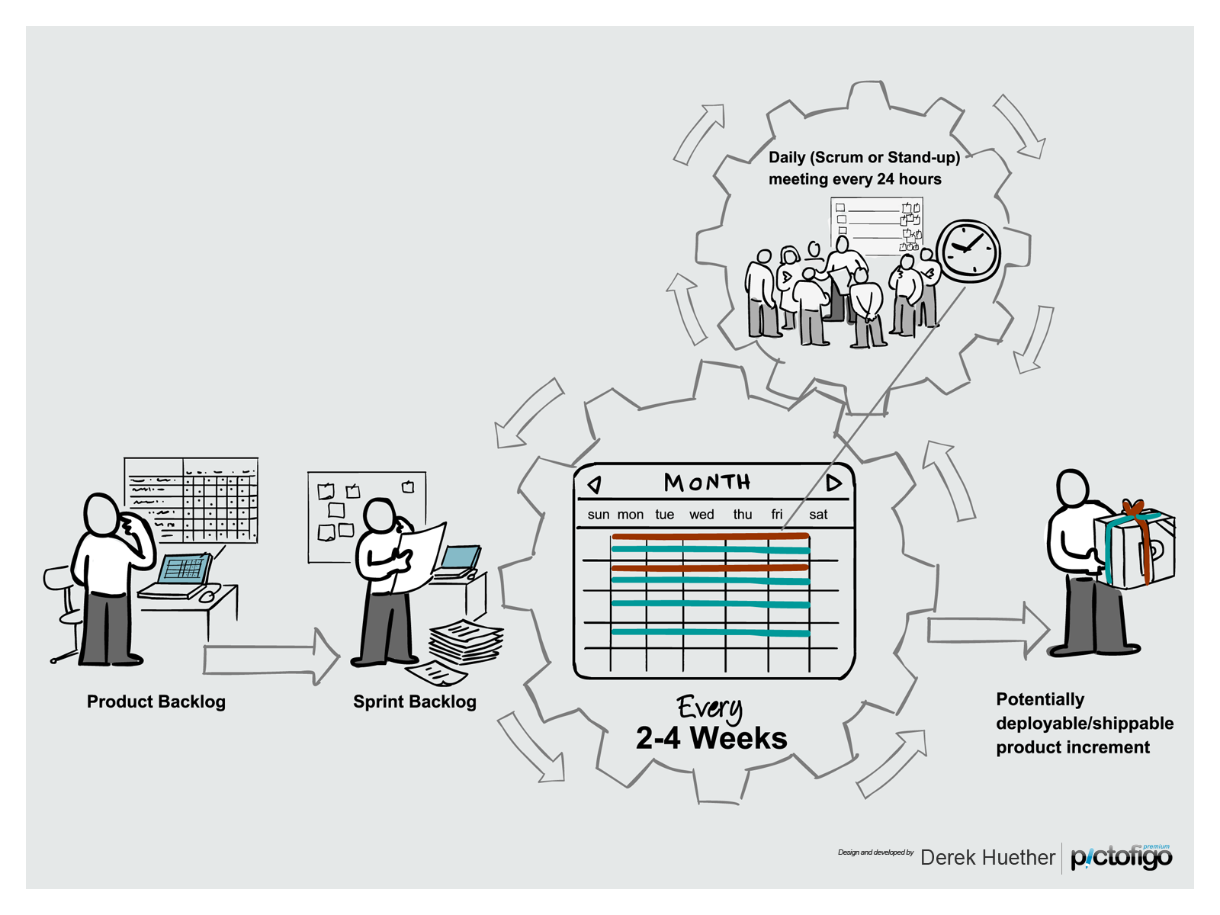
Scrum Process
Notes:
Scrum provides a simple system for iteratively delivering software in the context of fluid requirements through a series of sprints…

Slide 16
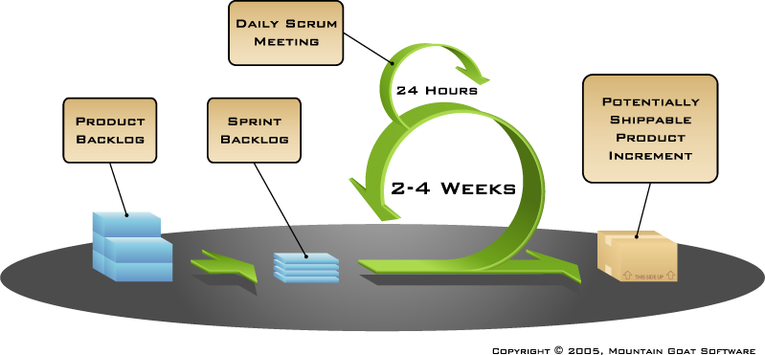
Scrum Process

Slide 17
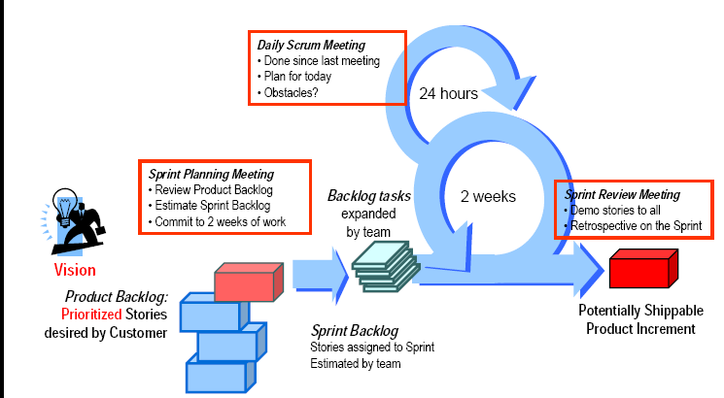
Scrum Process

Slide 18
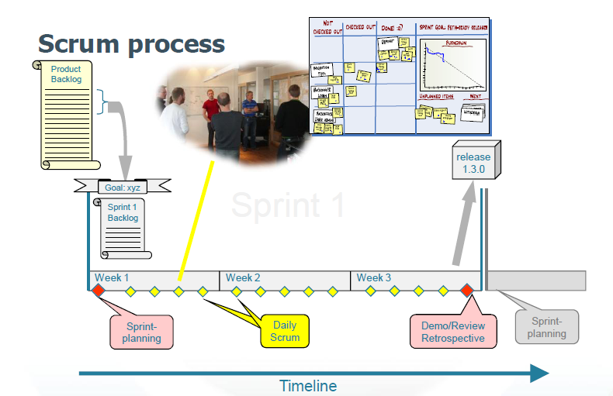
Scrum Process

Slide 19
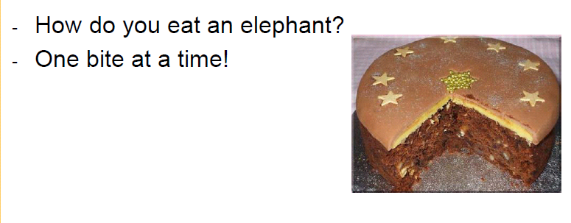
Iterative and Incremental Approach

Slide 20
Sprints
Scrum projects make progress in a series of “sprints”
Typical duration is 1–4 weeks or a calendar month at most
A constant duration leads to a better rhythm
Product is designed, coded, and tested during the sprint

Slide 21



No Changes During a Sprint
Change
Plan sprint durations around how long you can commit to keeping change out of the sprint

Slide 22
Scrum Framework
Roles
Product owner
ScrumMaster
Team
Ceremonies
Sprint planning
Sprint review
Sprint retrospective
Daily scrum meeting
Artifacts
Product backlog
Sprint backlog
Burndown charts

Slide 23

Scrum Roles
picture by exfordy

Slide 24
Scrum Framework
Roles
Product owner
ScrumMaster
Team
Ceremonies
Sprint planning
Sprint review
Sprint retrospective
Daily scrum meeting
Artifacts
Product backlog
Sprint backlog
Burndown charts

Slide 25
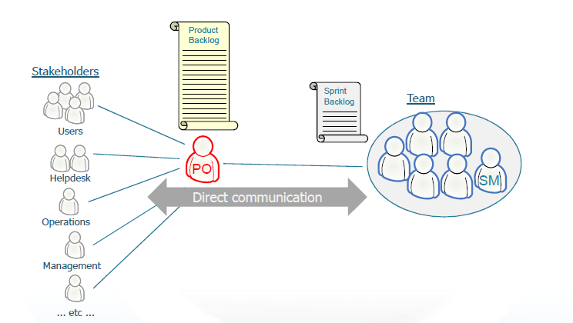
Scrum Structure

Slide 26
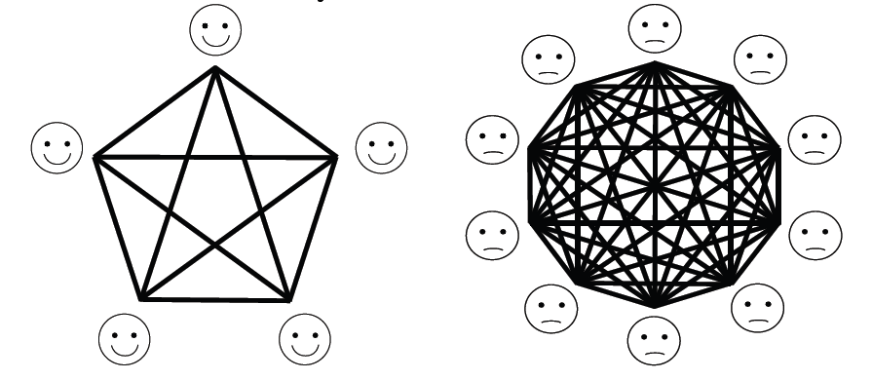
Team Size

Slide 27
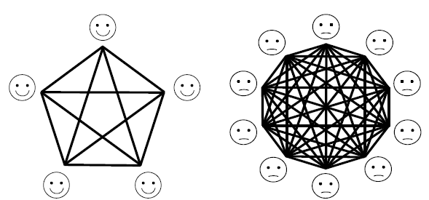
Communicaton Pathways Increase Geometrically with Team Size
Why a complete graph has n(n−1)/2 edges?

Slide 28










Roles
Scrum Master
Scrum Team
Product Owner
Stakeholders & Users

Slide 29
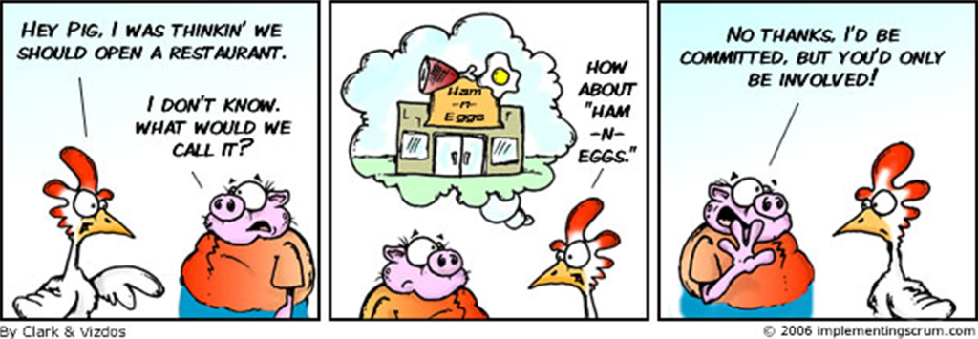
Pigs and Chickens
Product Owner
Scrum Master
Team Members
Users
Managers
Marketing

Slide 30
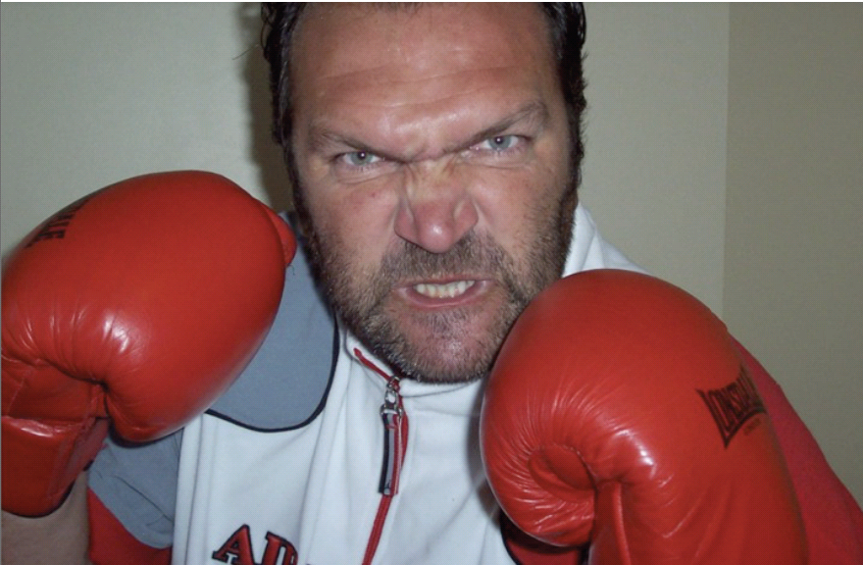
The Boss

Slide 31
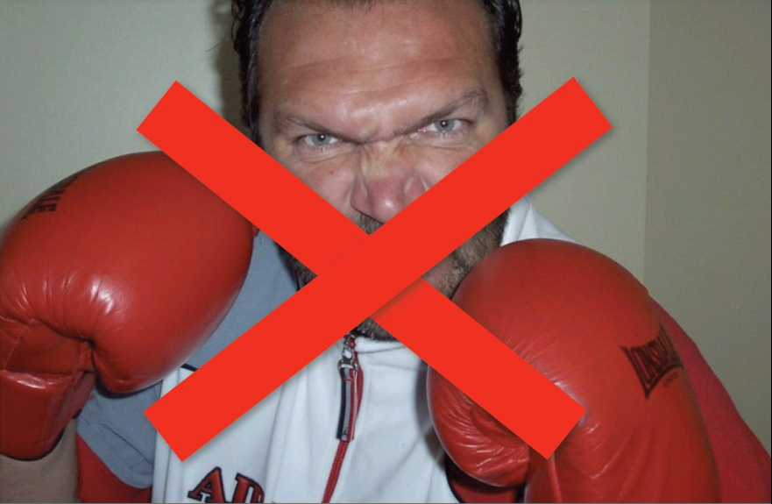
The Boss

Slide 32
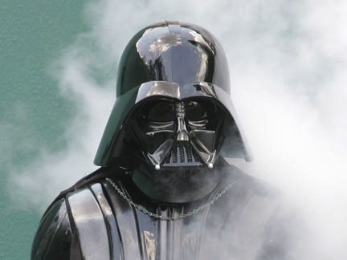
Product Owner
Owner of project vision
Represents the customer

Slide 33

Product Owner
Define the features of the product
Owns the Product Backlog
Decide on release date and content
Be responsible for the profitability of the product (ROI)
Prioritize features according to market value
Adjust features and priority every iteration, as needed
Accept or reject work results

Slide 34
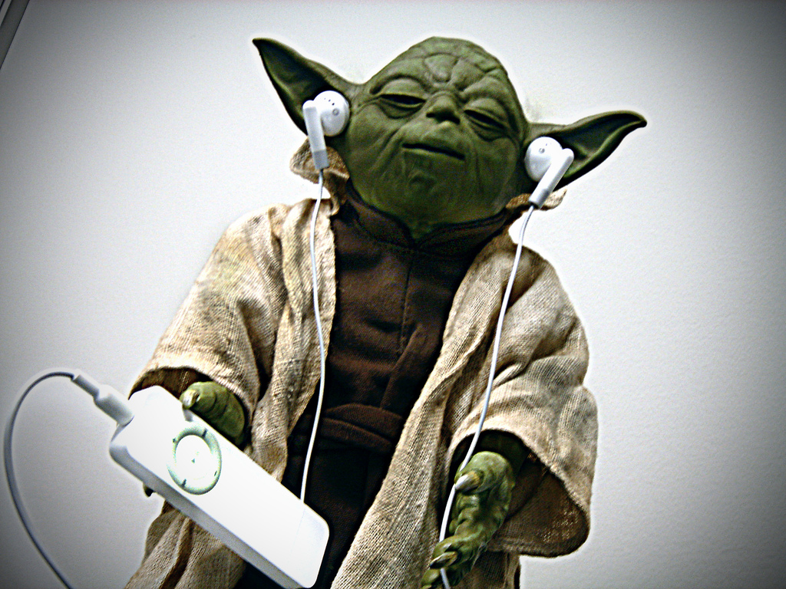
Scrum Master
Servant leader
Team protector
Troubleshooter
Scrum guide

Slide 35

The ScrumMaster
Represents management to the project
Responsible for enacting Scrum values and practices
Removes impediments
Ensure that the team is fully functional and productive
Enable close cooperation across all roles and functions
Shield the team from external interferences

Slide 36
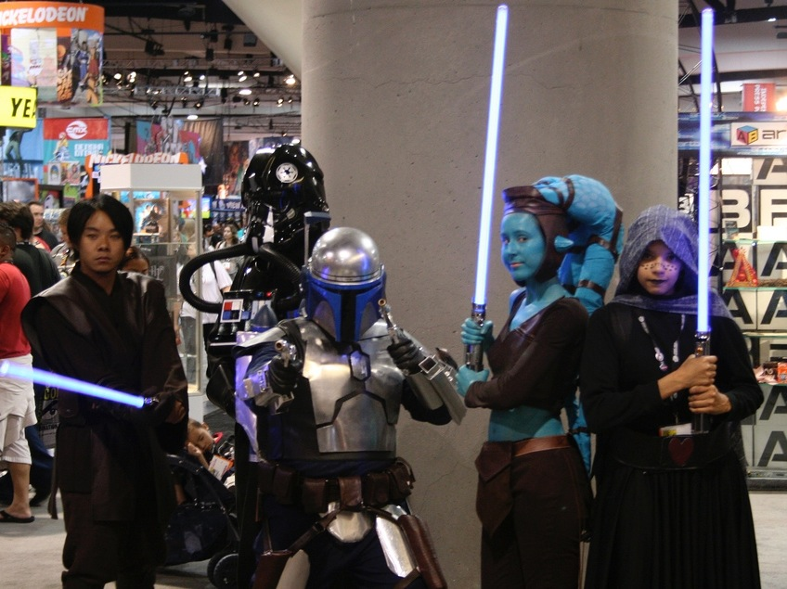
The Team
Small (5–9 people)
Colocated - Cross-functional
Self-organized - Full-time

Slide 37





The Team
Typically 5-9 people
Cross-functional:
Programmers, testers, user experience designers, etc.
Members should be full-time
May be exceptions (e.g., database administrator)
Teams are self-organizing
Ideally, no titles but rarely a possibility
Membership should change only between sprints

Slide 38
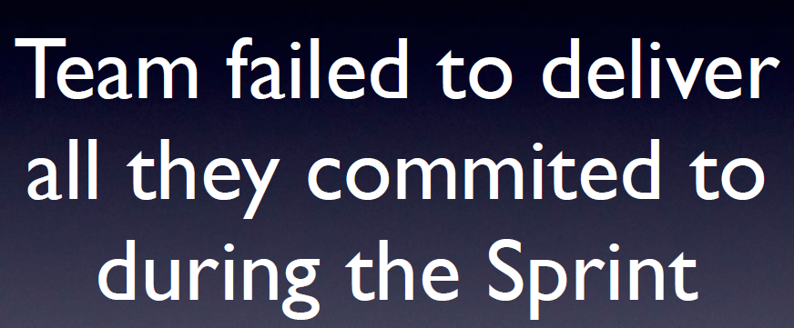

Slide 39
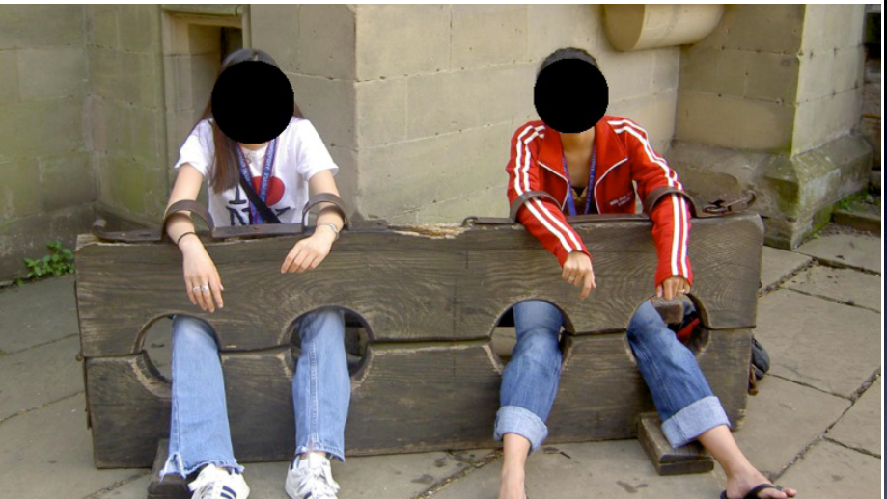

Slide 40
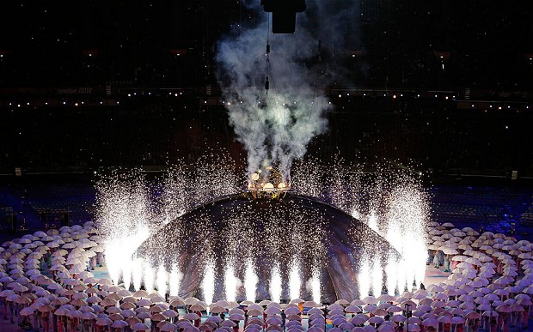
Ceremonies

Slide 41
Scrum Framework
Roles
Product owner
ScrumMaster
Team
Ceremonies
Sprint planning
Sprint review
Sprint retrospective
Daily scrum meeting
Artifacts
Product backlog
Sprint backlog
Burndown charts

Slide 42



Sprint planning meeting
Team capacity
Sprint prioritization
Analyze and evaluate product backlog
Select sprint goal
Sprint
goal
Product backlog
Business conditions
Sprint planning
Decide how to achieve sprint goal (design)
Create sprint backlog (tasks) from product backlog items (user stories / features)
Estimate sprint backlog in hours
Current product
Sprint
backlog
Technology

Slide 43
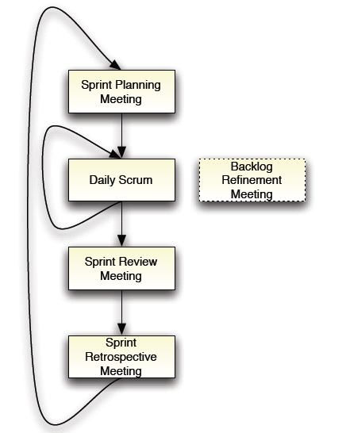
Scrum Meetings

Slide 44
Scrum Sprint
Planning meeting
Development
Stand-ups
Sprint
Testing
(1 or 2 weeks)
Review
Retrospective
Planning meeting
…

Slide 45
Scrum Board
Backlog
Development
Test
Ready

Slide 46

Sprint Planning
Team capacity, Product backlog,
Current product, Business, Technologies
+
Goal
=

Slide 47

Sprint Planning
Product owner and Team collaborately select items from the Product backlog they can commit to completing. The final Word is Product owner’s.
Sprint backlog is created
Tasks are identified and each is estimated (1-16 hours)
Collaboratively, not done alone by the ScrumMaster
High-level design is considered
As a vacation planner, I want to see photos of the hotels.
Code the middle tier (8 hours)
Code the user interface (4)
Write test fixtures (4)
Code the foo class (6)
Update performance tests (4)

Slide 48
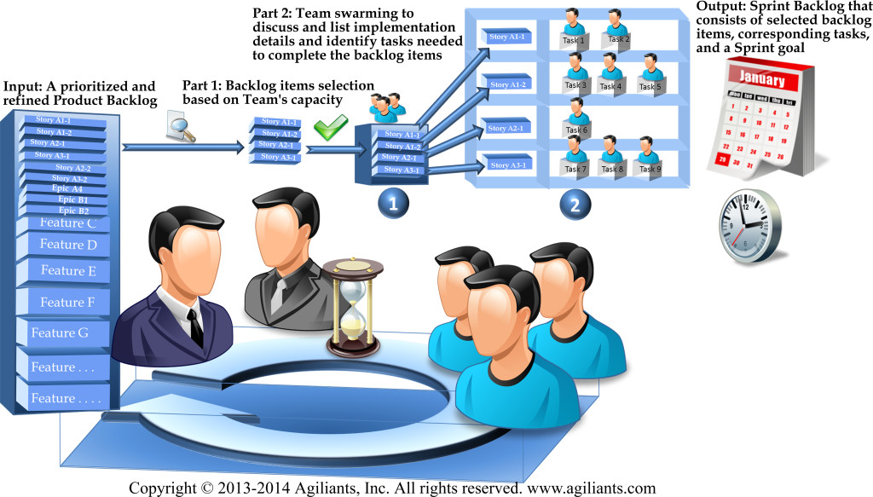
Sprint Planning
This meeting is a conversation between the Product Owner and the Team. That is, it’s up to the Product Owner to decide which stories are of the highest priority to the release and which will generate the highest business value, but the Team has the power to push back and voice concerns or impediments.

Slide 49
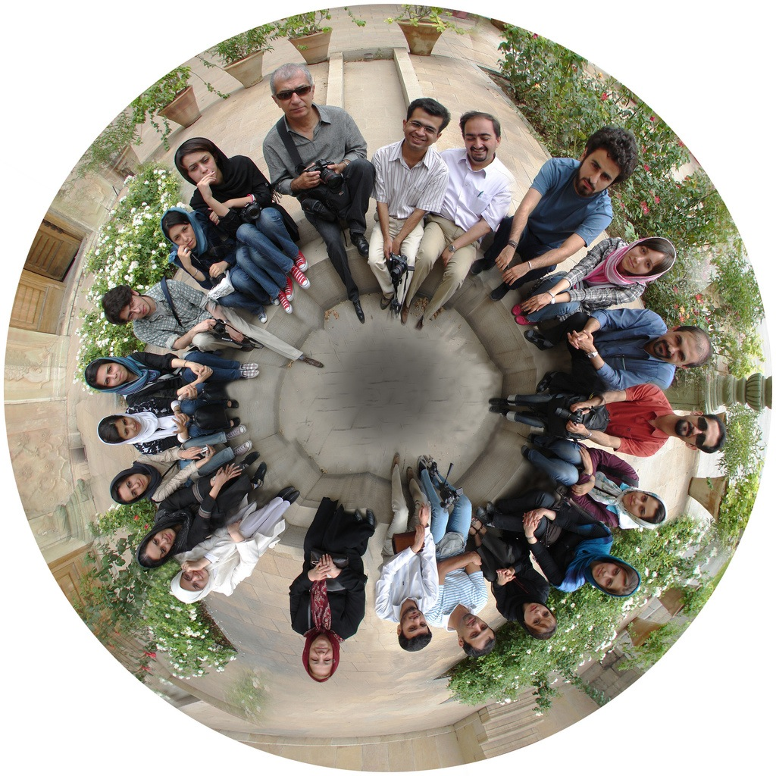
Daily Scrum
The heartbeat of Scrum

Slide 50
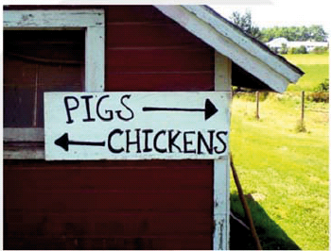
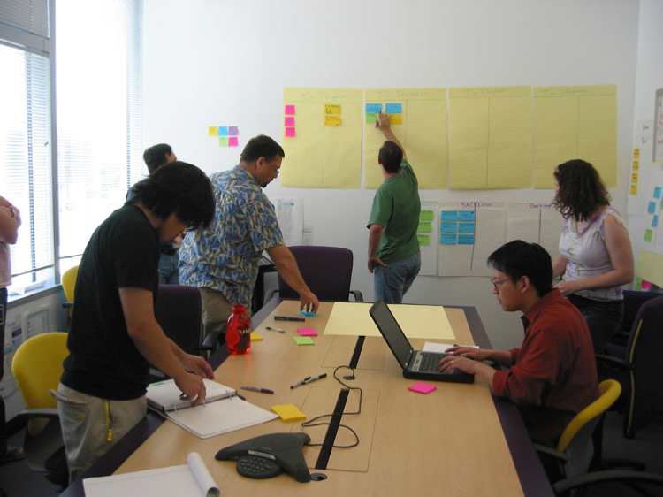
The Daily Scrum
Parameters
Daily
15-minutes
Stand-up
Not for problem solving
Whole world is invited
Only team members, ScrumMaster, product owner, can talk – “Chickens” and “Pigs”
Helps avoid other unnecessary meetings

Slide 51

Everyone Answers 3 Questions
1
What did you do yesterday?
2
What will you do today?
3
Is anything in your way?

Slide 52
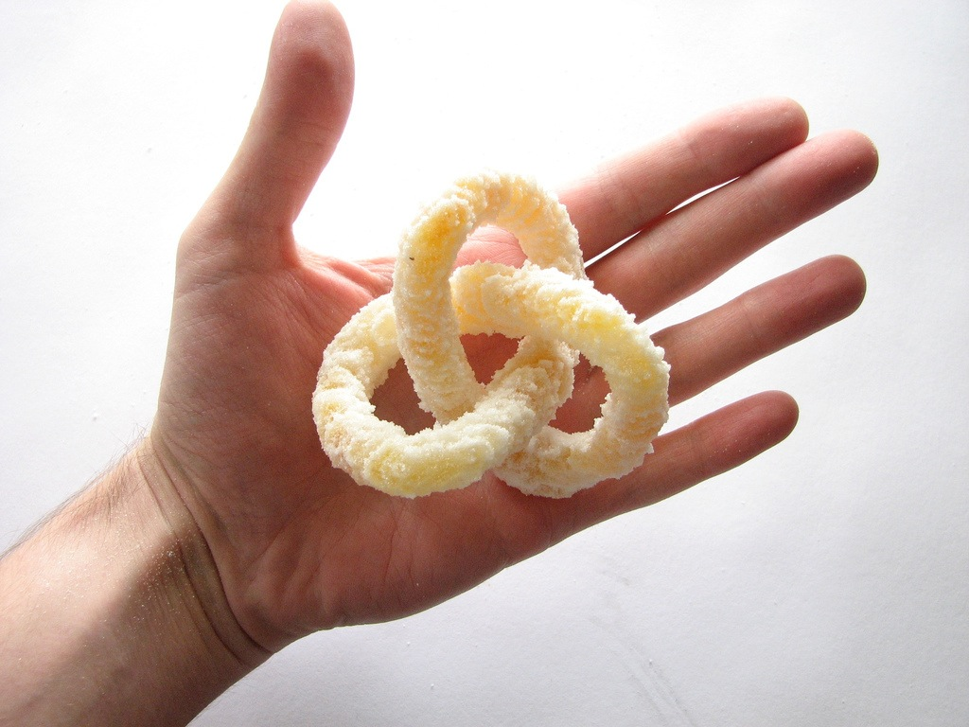
Sprint Review
Satisfy Product Owner
Get feedback on product
picture by oskay

Slide 53
Sprint Review
Informal, no slides
Whole team participates
The world is invited
picture by oskay

Slide 54
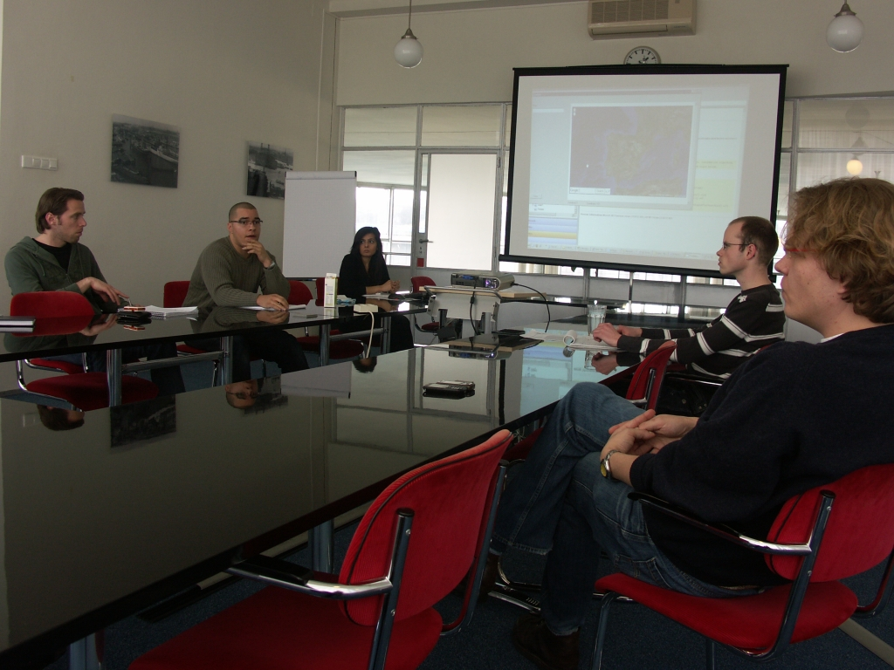
Sprint Review
Preparation needed
Show complete features
Accept or reject results
1-2 hours
per sprint/week

Slide 55
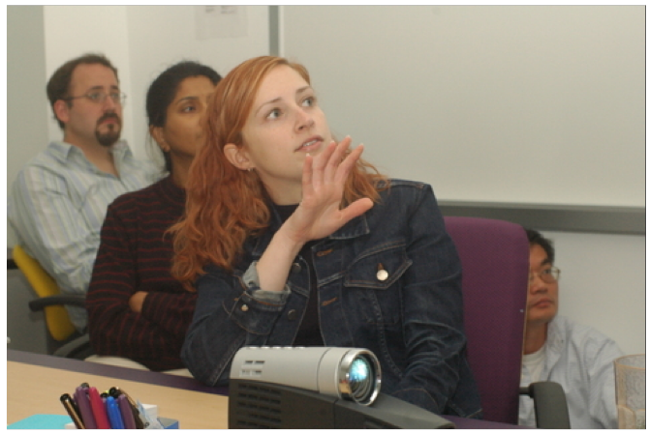
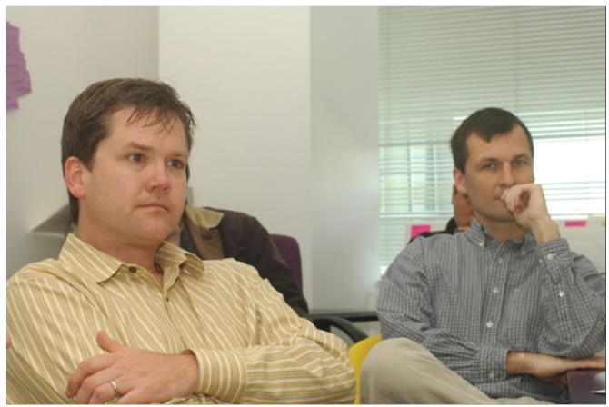
The Sprint Review
Team presents what it accomplished during the sprint
Typically takes the form of a demo of new features or underlying architecture
Informal
2-hour prep time rule
No slides
Whole team participates
Invite the world

Slide 56

Sprint Retrospective
Reflect on process and product
Whole team participates

Slide 57

Sprint Retrospective
Periodically take a look at what is and is not working
Typically 15–30 minutes
Done after every sprint
Whole team participates
ScrumMaster
Product owner
Team
Possibly customers and others

Slide 58

Start / Stop / Continue
Whole team gathers and discusses what they’d like to:
Start doing
Stop doing
This is just one of many ways to do a sprint retrospective.
Continue doing

Slide 59
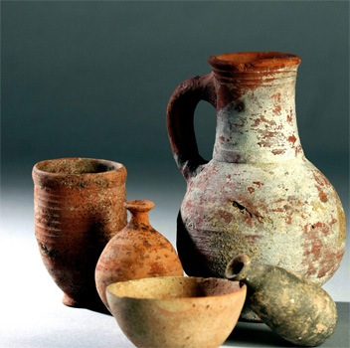
Artifacts

Slide 60
Scrum Framework
Roles
Product owner
ScrumMaster
Team
Ceremonies
Sprint planning
Sprint review
Sprint retrospective
Daily scrum meeting
Artifacts
Product backlog
Sprint backlog
Burndown charts

Slide 61




Artifacts
Product Vision
Product Backlog
Release Plan
Sprint Backlog
Sprint Burndown
Impediment List

Slide 62
Product Backlog

Slide 63
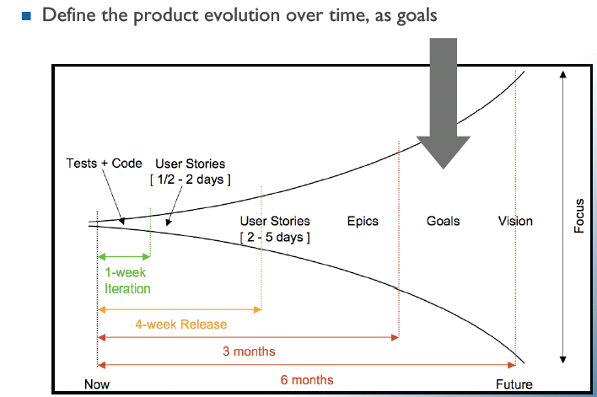
Product Roadmap Planning
Goals

Slide 64
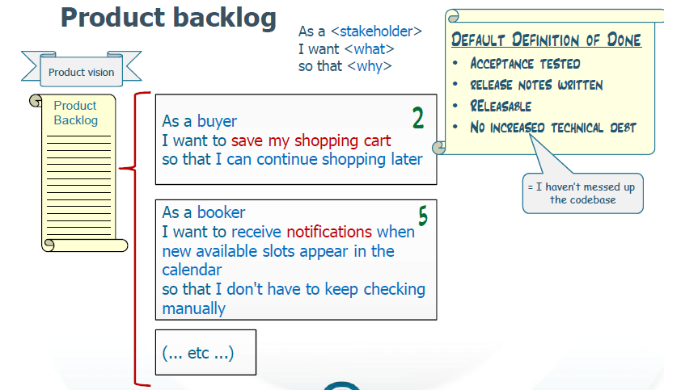
Product Backlog

Slide 65
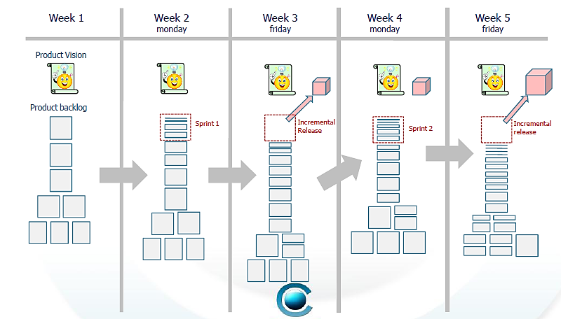
Evolution of a Product Backlog

Slide 66





User Stories
Technical Requirements
Bugs
Prioritized by Value
Estimated by the Team
Product Owner

Slide 67

Product Backlog
The requirements
A list of all desired work on the project
Ideally expressed such that each item has value to the users or customers of the product
Prioritized by the product owner
Reprioritized at the start of each sprint
This is the product backlog

Slide 68
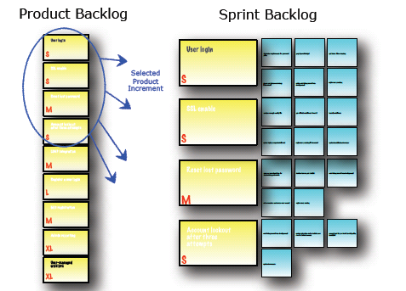
Product Backlog
Is only a FORECAST!-> is not exact

Slide 69
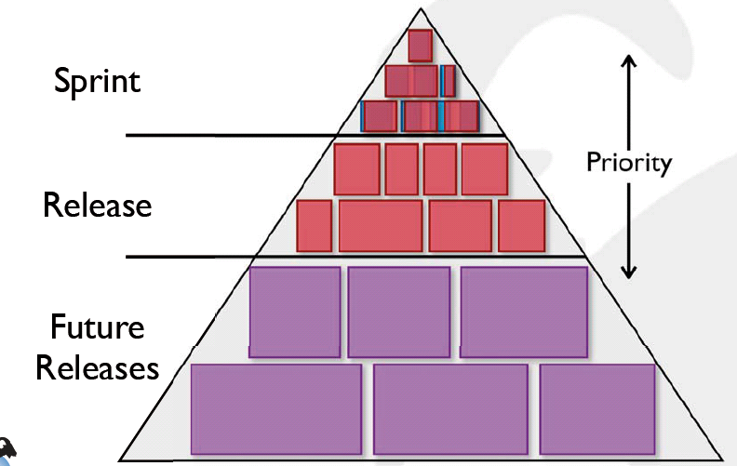
The Product Backlog Iceberg

Slide 70
A Sample Product Backlog
Backlog item | Estimate
Allow a guest to make a reservation | 3
As a guest, I want to cancel a reservation. | 5
As a guest, I want to change the dates of a reservation. | 3
As a hotel employee, I can run RevPAR reports (revenue-per-available-room) | 8
Improve exception handling | 8
... | 30
... | 50

Slide 71
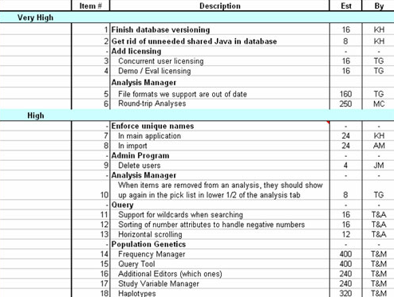
Product Backlog
Includes rough
estimates
Prioritized by
value & risk
Better to describe
as user stories
Publicly
visible

Slide 72
Estimation of Product Backlog Items
Establishes team’s velocity (how much Effort a Team can handle in one Sprint)
Determining units of complexity.
Size-category (“T-Shirt size”)
Story points
Work days/work hours
Methods of estimation:
Expert Review
Creating a Work Breakdown Structure (WBS)

Slide 73
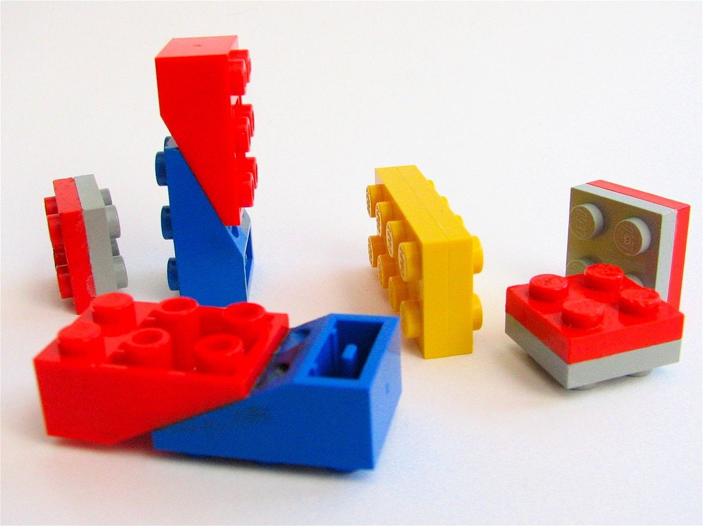
Sprint Backlog
Breakdown of business value into assignable tasks

Slide 74
The Sprint Goal
A short statement of what the work will be focused on during the sprint
Life Sciences
Support features necessary for population genetics studies.
Database Application
Make the application run on SQL Server in addition to Oracle.
Financial services
Support more technical indicators than company ABC with real-time, streaming data.

Slide 75
Sprint Backlog
A subset of Product Backlog Items, which define the work for a Sprint.
Product owner and Team together select items from the Product backlog they can commit to completing
Sprint Backlog’s stories are decomposed to Tasks by Team
Is owned by Team
Each Item has it’s own status
Should be updated every day

Slide 76
Sprint Backlog
No more then 300 tasks in the list
If a task requires more than 16 hours, it should be broken down
Team can add or subtract items from the list. Product Owner is not allowed to do it

Slide 77
Sprint Backlog
Is a FORECAST!
Is a good warning monitor

Slide 78
Managing the Sprint Backlog
Individuals sign up for work of their own choosing
Work is never assigned
Estimated work remaining is updated daily
Any team member can add, delete or change the sprint backlog
Work for the sprint emerges
If work is unclear, define a sprint backlog item with a larger amount of time and break it down later
Update work remaining as more becomes known

Slide 79
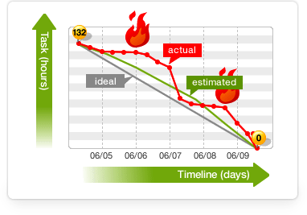
Sprint Burndown Chart

Slide 80
Sprint Burndown Chart
Depicts the total Sprint Backlog hours remaining per day
Shows the estimated amount of time to release
Ideally should burn down to zero to the end of the Sprint
Actually is not a straight line
Can bump UP

Slide 81
A Sprint Backlog
Tasks
Mon
Tues
Wed
Thur
Fri
Code the user interface
8
4
8
Code the middle tier
16
12
10
4
Test the middle tier
8
16
16
11
8
Write online help
12
Write the foo class
8
8
8
8
8
Add error logging
8
4

Slide 82

Tasks
Mon
Tues
Wed
Thur
Fri
Code the user interface
8
4
8
Code the middle tier
16
12
10
7
Test the middle tier
8
16
16
11
8
Write online help
12
50
40
30
Hours
20
10
0
Mon
Tue
Wed
Thu
Fri

Slide 83
350 hrs.
Work Hours Remaining
0 hrs.
Time

Slide 84
SCRUM PROCESS

Slide 85


First an idea
85

Slide 86

Then a Vision
86

Slide 87
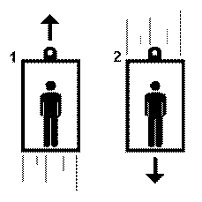
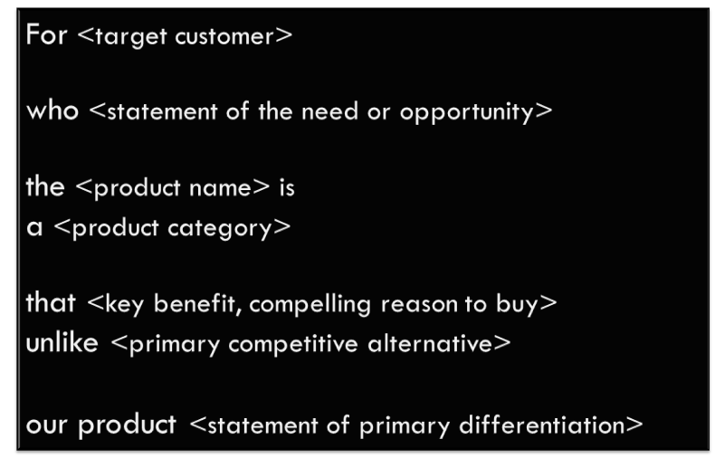
The Vision
The elevator test: "Can you explain your product in the time it takes to ride up in an elevator?"
87

Slide 88


Then a Product Backlog
88

Slide 89
The Product Backlog -- Releases
High priority
Sprint
Medium Priority
Release
Future Releases
89

Slide 90
Release Planning
Product Backlog
3
Sprint 1
3
2
Release 1
3
Sprint 2
1
3
3
Sprint 3
2
3
3
Release 2
Sprint 4
5
Sprint 5
8

Slide 91
A Sprint Backlog
Tasks
Mon
Tues
Wed
Thur
Fri
Code the user interface
8
4
8
Code the middle tier
16
12
10
4
Test the middle tier
8
16
16
11
8
Write online help
12
Write the foo class
8
8
8
8
8
Add error logging
8
4

Slide 92
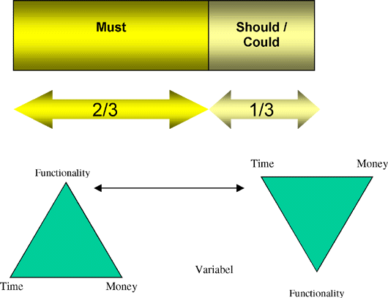
MoSCoW rules
Stories prioritization technique referred to as the MoSCoW rules. MoSCoW is an acronym for
Must have
Should have
Could have
Won't have this time

Slide 93
The Daily Scrum
Parameters
Daily
15-minutes
Stand-up
Not for problem solving
Whole world is invited
Only team members, ScrumMaster, product owner, can talk – “Chickens” and “Pigs”
Helps avoid other unnecessary meetings

Slide 94


Scrum vs. XP

Slide 95





Standish Group from 2001 to 2011
eXtreme Programming (XP): 38% → 4%
Scrum: 3% → 58%

Slide 96

Standish Group 2012

Slide 97



Scrum & XP
Whatever XP practices you like
Scrum

Slide 98

Scrum and XP (most common practices)
Pair programming
Test-driven development
Collective code ownership
Coding standards

Slide 99
SUMMARY

Slide 100
Scrum Summary
The Product Owner sets a List of Features called Product Backlog
During the Sprint Planning, the Product Owner determines a piece of the top of that list: the Sprint Backlog; and decide how to implement it.
The Team has a time-box to reach this goal: the Sprint
❶

Slide 101
Scrum Summary
Each day, the Team measures its progress during a 15’ meeting: the Daily Scrum
During the whole project, the Scrum Master ensures that the Team is still focused on its objective.
At the end of the Sprint, the work has to be potentialy shipable. This work is considered as done.
❷

Slide 102
Scrum Summary
The Sprint ends with the Sprint Review and the Retrospective.
The Scrum process is done when all Stories are implemented, or the budget is consummed, or when the time is over.
❸

Slide 103

Scrum in 3 Steps

Slide 104

Scrum

